Slide 1
BOM maintain process flow

Slide 2
Bom maintained in Standard T code
Based On spec Maintained in YPU20 – Spec for tyre Will come IN YPR36 ‘which will used on shopfloor for Tyre manufacturing’
Based On Spec Maintained In YPU20 product weight is Calculated
1
2
3
4
5
If Any change Done In Spec Then weight for Product will also change
Spec Maintained for FG And SFg in Custom T Code- YPU20
Based On spec Maintained IN YPU20 RM requirement and sfg Qty will Update In BOM ( BOM has to Manual Trigger once Spec is Maintained )
6
7
8
Weight can Be Maintained manually by using Custom T-code – YPU25
Weight Of Fg good Keep Changing Based On spec – weight of Fg code update in Custom table day wise through Background Jobs

Slide 3
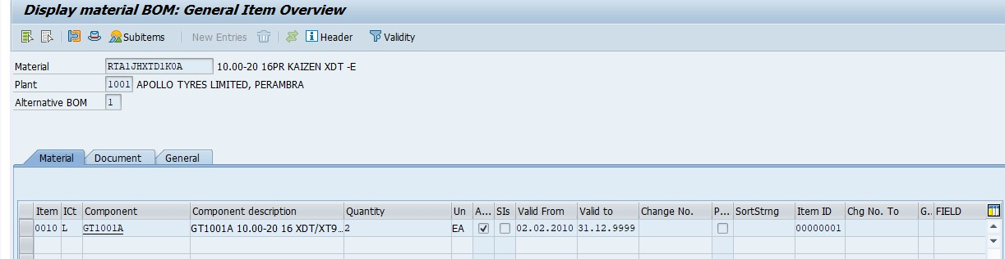
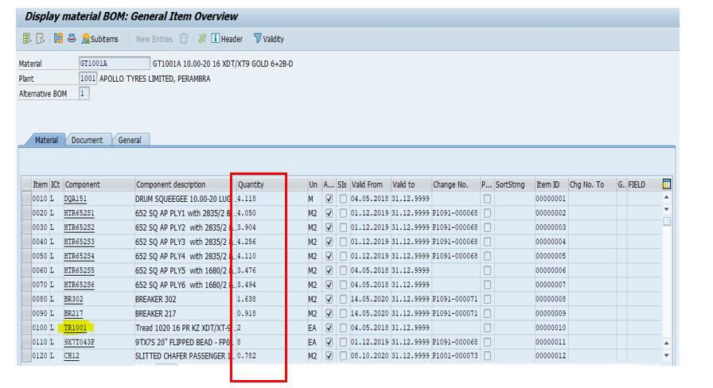
Bom maintained in Standard T code
1
T-Code | Description
CS01 | Create
CS02 | Change
CS03 | Display
Bom Level 00
BOM Level 01
Manual Component Qty has to Maintain Here at the time of New BOM

Slide 4
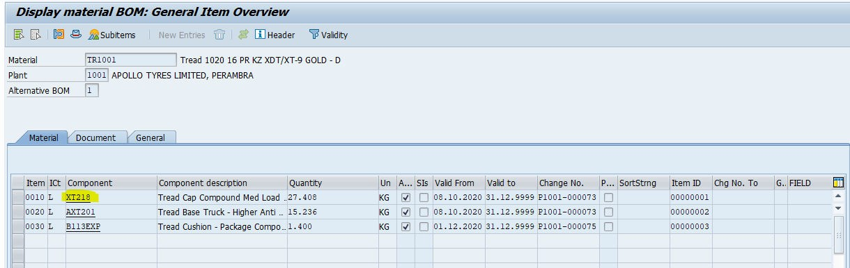
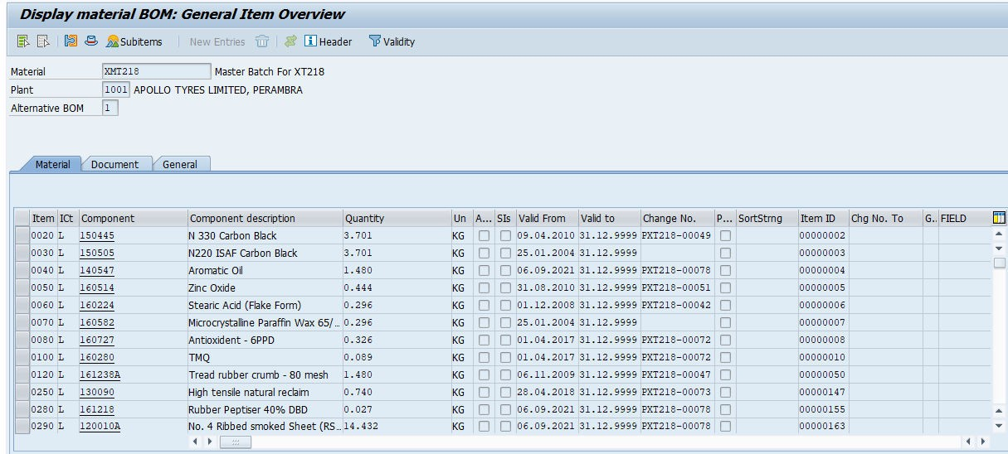
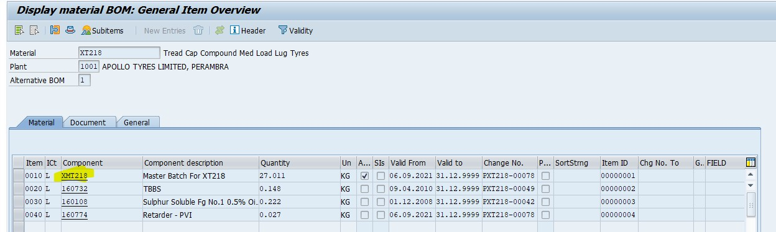
Bom Level 03
Bom Level 05
Bom Level 04

Slide 5
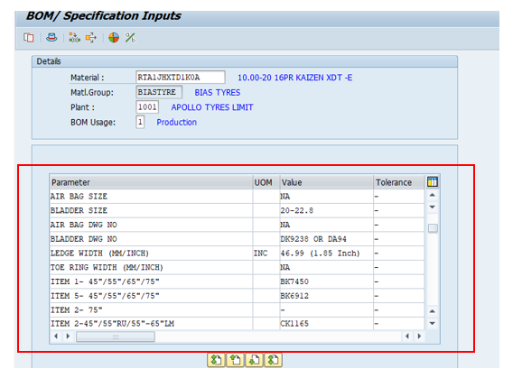
2
Spec Maintained for FG And SFg in Custom T Code- YPU20
T - Code | Description | Table Name | Program name
YPU20 | BOM/ Specification Input | YPA_BOM_PARAM | SAPMYP_BOM_MATL_PARM_MAINT
Spec Maintain IN YPU20 For FG/SFG
Output Of YPU20 Comes in YPR36
Weight Manually Maintain In YPU25
Bom Level 00
Based On the Parameter Value Component Qty will be Weight / Press spec Report will be Generated in YPR36

Slide 6
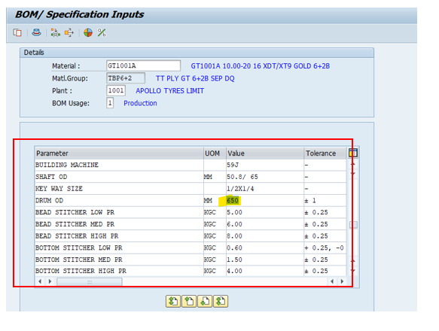
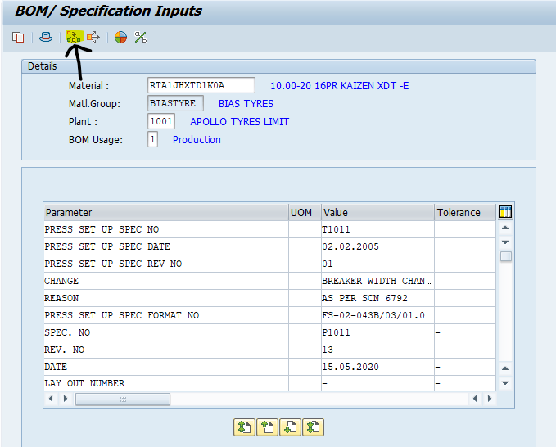
Based On the Parameter Value Component Qty will be Calculated for GT Code
Click On Marked Option ( Green Tyre Component Input)
Maintain GT code In Marked Field and Hit Enter

Slide 7
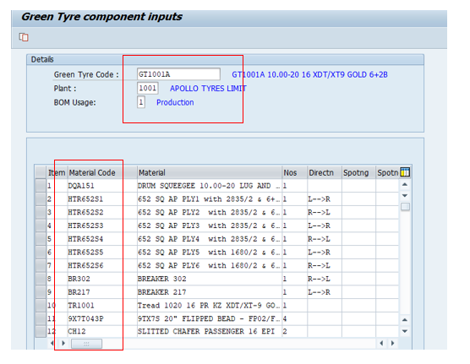
Same Component to be maintained in Standard Bom

Slide 8
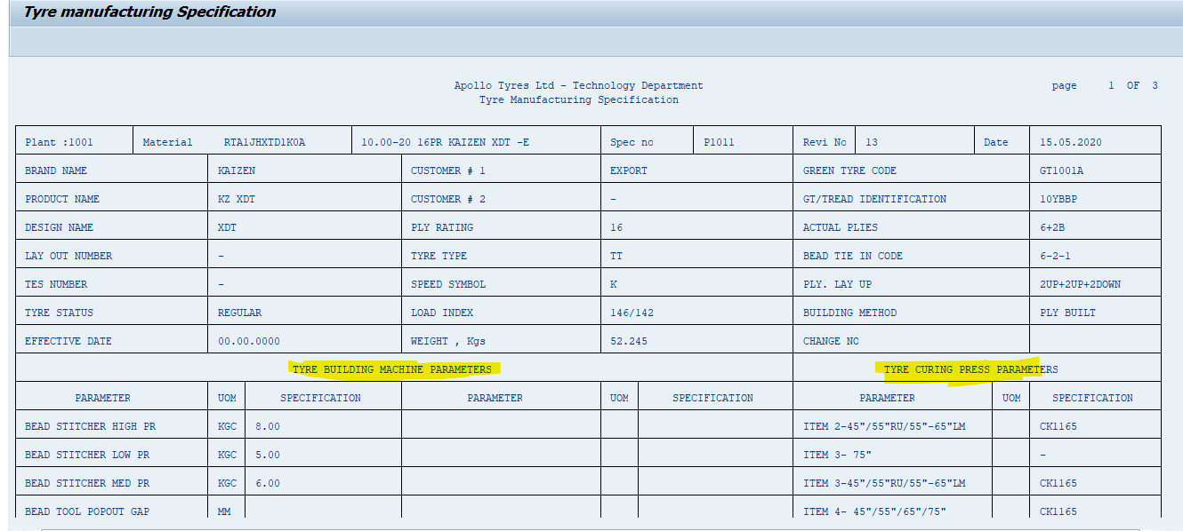
Output of YPU20 Output
3
T - Code | Description | Table Name | Program name
YPR36 | Tyre Manufacturing Specification | YPA_BOM_PARAM | YPCPR13_TYRE_MANUFACTURE_SPEC1
Sheet 01 of 03

Slide 9
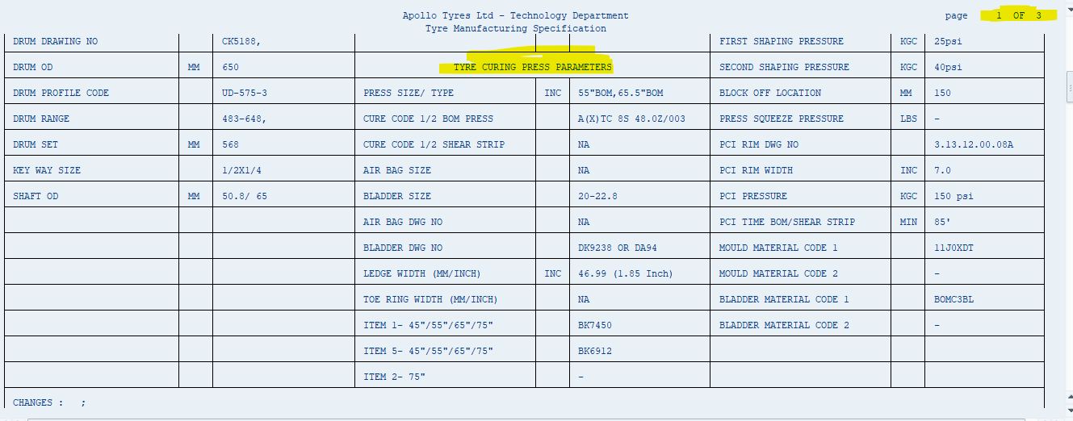

Slide 10
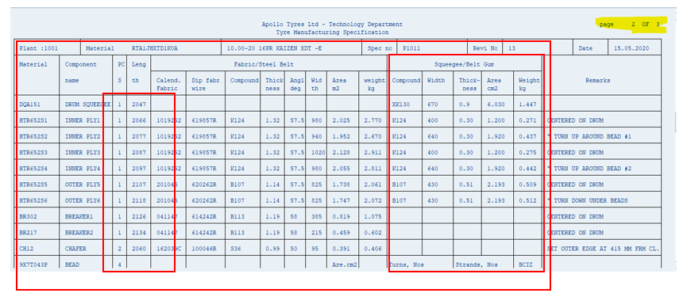
Based On Parameter Maintained in YPU20 Length & other value calculated.
Sheet 02 of 03
Weight Calculation part is in Next Slides

Slide 11
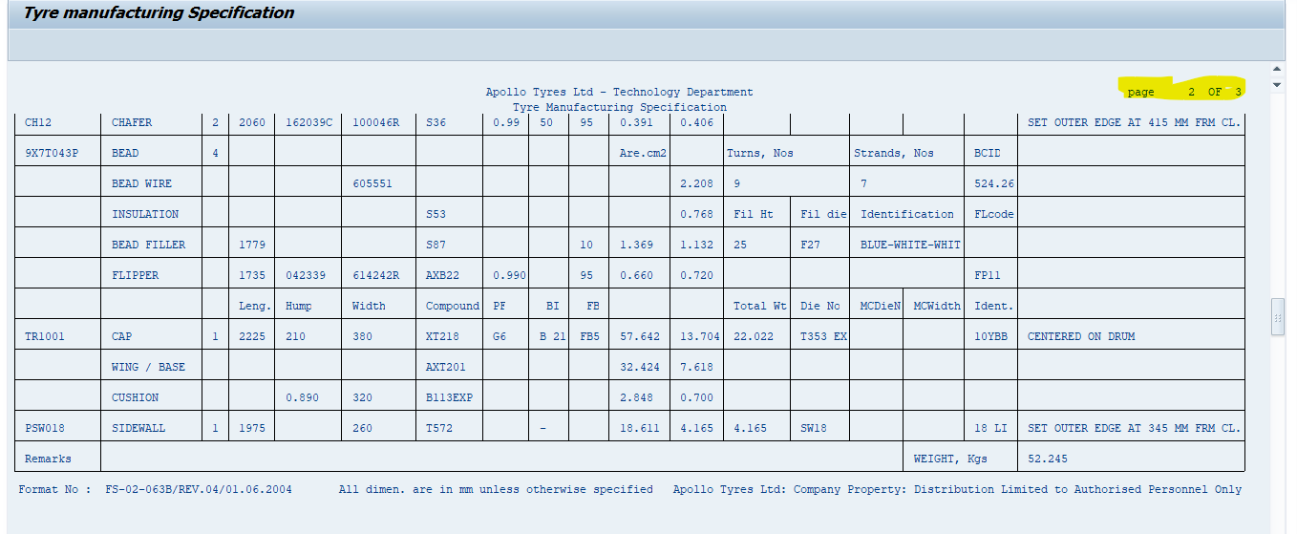

Slide 12
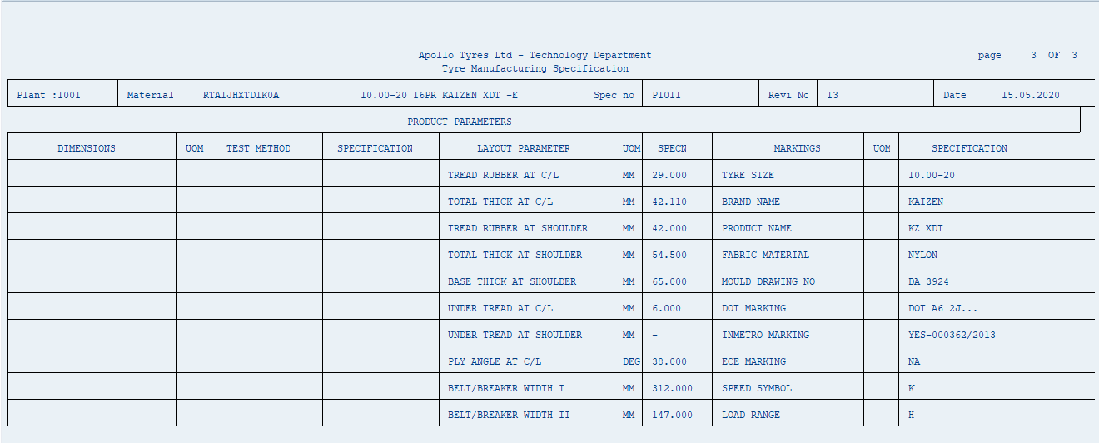
Sheet 03 of 03

Slide 13
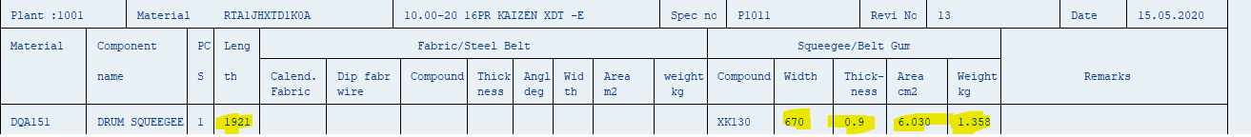
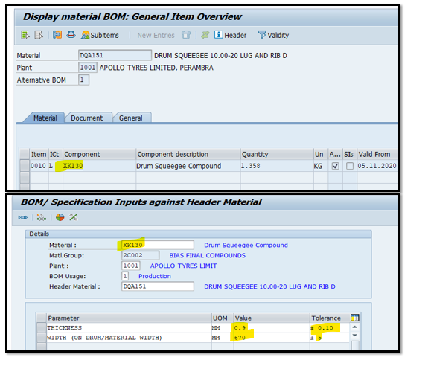
*Weight Calculations From Spec – Example *Sheet 02 of 03
1
3
2
Drum Squeegee, Inner Liner
Area = Width * Thickness / 100
Weight = Area * Length * Sp. Gravity /1000
Length of drum squeegee/IL/ Ply = (Drum OD+build up+component gauge)*pi
CS03- BOM Display
1. Area Calculation
Area Calculation Based on Parameter Maintained in YPU20
Thickness | 0.9
Width | 670
Area = Width * Thickness / 100 | 670 * 0.9 / 100 = 6.030 cm2
YPU20 Screen
1

Slide 14
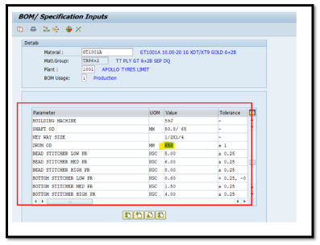
2. Length of drum squeegee/IL/ Ply
Length of drum squeegee/IL/ Ply
Drum OD | 610 MM
Build UP | -
Component Gauge | 0.9 MM
Length of drum squeegee/IL/ Ply = (Drum OD+build up component gauge)*pi | = (610 +0.9) *3.14= 1918.226 Round off = 1921

Slide 15
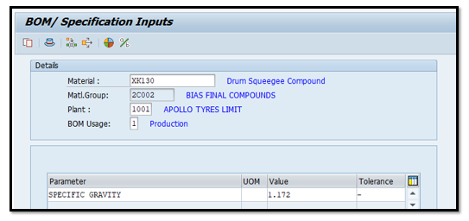
3. Weight Calculation
YPU20 Screen
Weight Calculation Based on Parameter Maintained in YPU20
Area | 6.030 cm2
Length of drum | 1921 mm & 19.21 cm
Specific Gravity | 1.172
Weight = Area * Length * Sp. Gravity /1000 | 6.030 * 19.21 *1.172 /1000 = 1.3567 kg

Slide 16
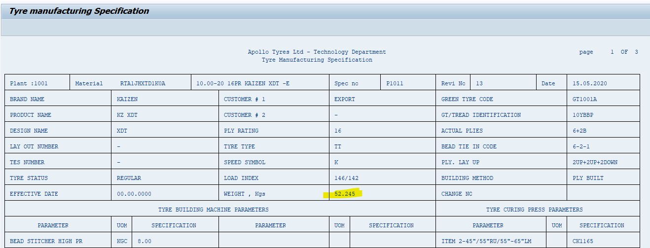
Weight Calculation for FG code
Total Weight of Tyre – 52.245 Kg
Sheet 01 of 03
YPR36 Screen

Slide 17
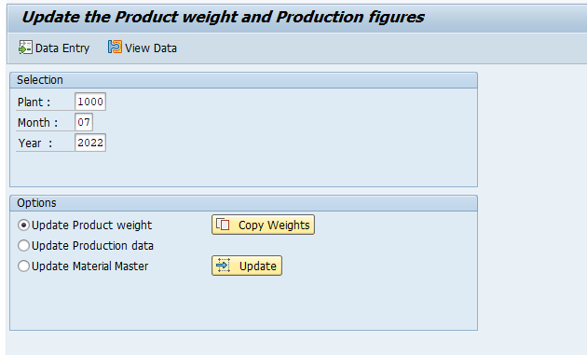
T - Code | Description | Table Name | Program name
YPU25 | Update the Product Weight & Production Figure | YPA_Product_wt | SAPMYP_TYRE_WEIGHT_PROD_V2
Based on the Parameter in YPU20 weight is calculated it shows In YPR36
Manual weight has to Maintain for same Period IN YPU25
YPU25 Screen

Slide 18
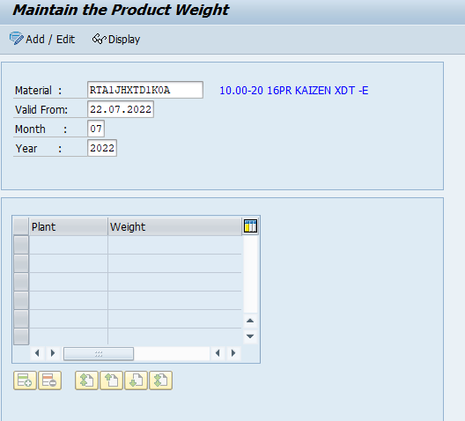
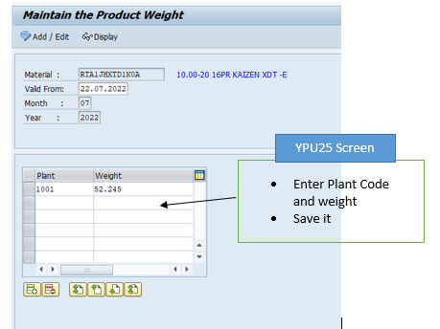
Enter Material and click on Add/edit
YPU25 Screen
Note: - Weight Maintain is one Time activity after Maintain Manual weight in YPU25, it will be keep updating on daily basis through the background job, weight will be Updated in TABLE YPA_PRODUCT_WEIGHT

Slide 19
Job Name | Variant Name | Program Name
PRODUCT WEIGHT UPDATION -AP | AP WT | YPA_PRODUCT_WT_UPD_BG
PRODUCT WEIGHT UPDATION -BARODA | BARODA WT | YPA_PRODUCT_WT_UPD_BG
PRODUCT WEIGHT UPDATION -CHENNAI | CHENNAI WT | YPA_PRODUCT_WT_UPD_BG
PRODUCT WEIGHT UPDATION -KALAMAS | KALAM WT | YPA_PRODUCT_WT_UPD_BG
PRODUCT WEIGHT UPDATION -PERAMBR | PERAMBRA WT | YPA_PRODUCT_WT_UPD_BG

